Slide 1
MP3 player

Slide 2
Introduction
The project is a simple Mp3 player which is able to any type of any audio file present in the system. The project also includes the functionality of creating a queue/playlist and will include common features such as 'rewind’, 'stop’, 'mute' and 'play', also the project will include the functionality of increasing or decreasing the volume.

Slide 3
Libraries Used
Tkinter :
Built-In Python GUI Library, no installation needed
Pygame :
The mixer module from Pygame is used to load and play sounds.
Installation Command : pip install pygame.
Mutagen :
Used to collect meta data of audio files like mp3.
Installation Command : pip install mutagen

Slide 4
Steps
Creating a window using Tkinter.
Adding Status and Menu bar in the window.
Dividing the window into the left frame and right fame.
Dividing the right frame into top, middle and bottom layers.
Assigning buttons to the respective frames.
Creating the list box in the left frame.
Assigning specific functions to their respective buttons.

Slide 5
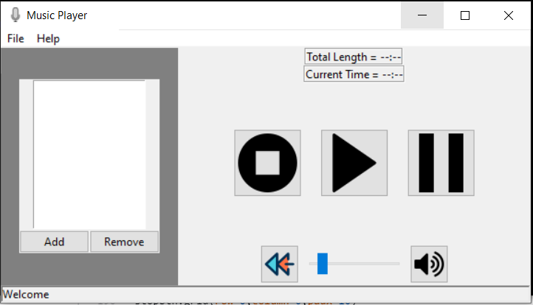
Result

Slide 6
THANK YOU

